Slide 1
Normalization
C393: Database Systems

Slide 2
Lesson Objectives
Discuss the difference between 1NF, 2NF, and 3NF
Apply normalization to a database design

Slide 3
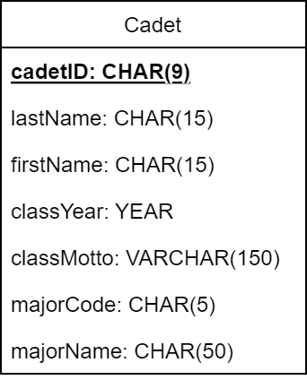
Spreadsheet Syndrome
Developers tend to lump all information into as few tables as possible
Schemas suffer data redundancies, data anomalies, and other inefficiencies
Normalization brings tables into compliance with series of normal forms
Normalization is not a separate step of design, but can be used when:
Developing data model
Translating data model to schema
Notes:
What is wrong with this schema on the left? – This has more information than the Cadet class from the DCA Model from last lesson
- Lots! Don't get wrapped up in how bad it is; it's bad.
Redundant information, which leads to data anomalies
What information is redundant?
classYear, classMotto, majorCodes, majorNames
*Normalization* clarifies and codifies "what's wrong" and helps us fix it systematically.
Database normalization is a process to modify an existing schema:
bring its component tables into compliance with a series of progressive normal forms.
Levels of normalization must be done in order (1NF, 2NF, 3NF)
Normalization is not a goal of design, but merely a method to ensure a robust and extendable design
Not a separate step, but can be used when
Developing data model
Translating data model to schema

Slide 4
Spreadsheet Syndrome
Developers tend to lump all information into as few tables as possible
Schemas suffer data redundancies, data anomalies, and other inefficiencies
Normalization brings tables into compliance with series of normal forms
Normalization is not a separate step of design, but can be used when:
Developing data model
Translating data model to schema
Notes:
What is wrong with this schema on the left? – This has more information than the Cadet class from the DCA Model from last lesson
- Lots! Don't get wrapped up in how bad it is; it's bad.
Redundant information, which leads to data anomalies
What information is redundant?
classYear, classMotto, majorCodes, majorNames
*Normalization* clarifies and codifies "what's wrong" and helps us fix it systematically.
Database normalization is a process to modify an existing schema:
bring its component tables into compliance with a series of progressive normal forms.
Levels of normalization must be done in order (1NF, 2NF, 3NF)
Normalization is not a goal of design, but merely a method to ensure a robust and extendable design
Not a separate step, but can be used when
Developing data model
Translating data model to schema

Slide 5
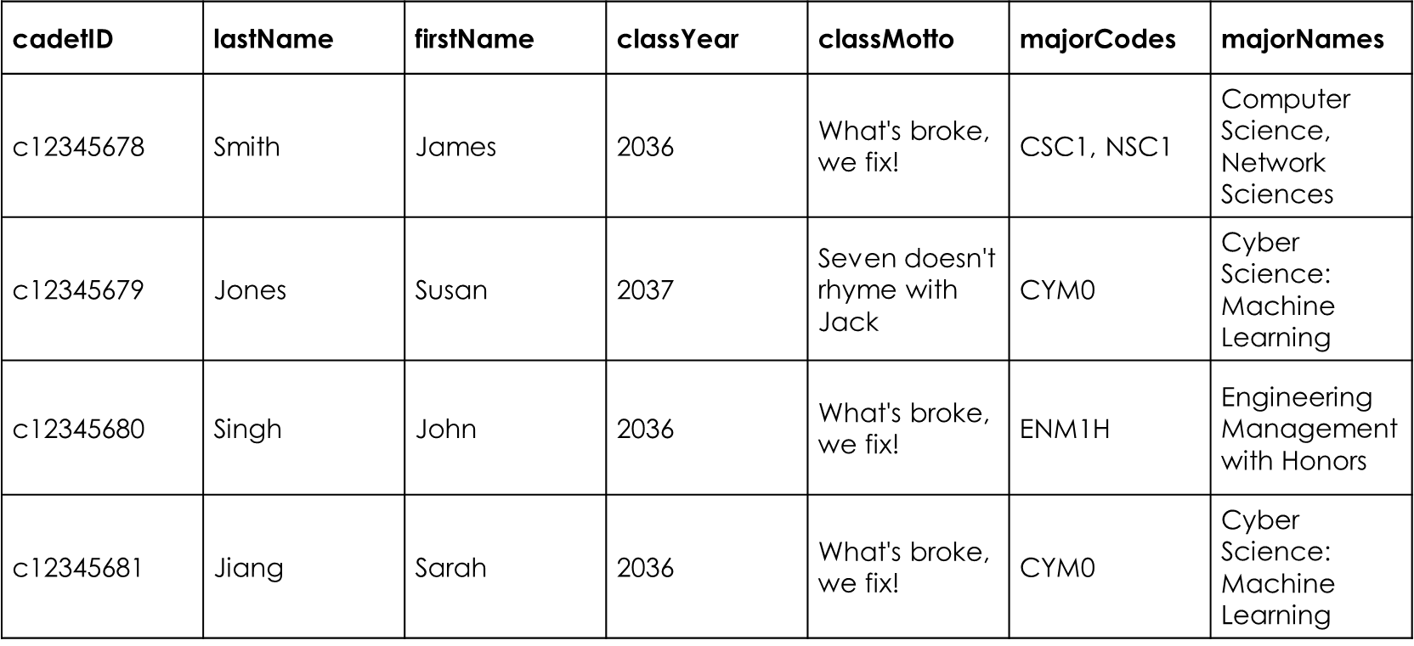
Unnormalized SpreadSheet
Multiple values for one attribute (Bad!)

Slide 6
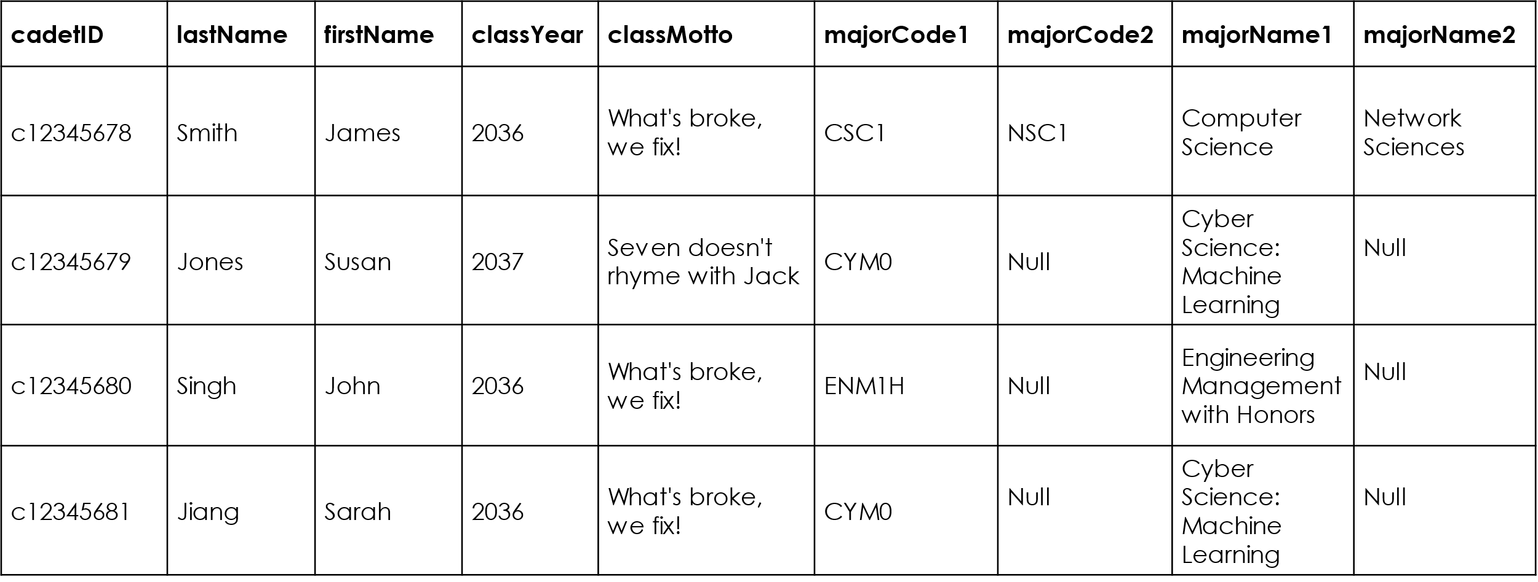
Unnormalized SpreadSheet
Multiple values for one attribute (Bad!)

Slide 7
The Spreadsheet
cadetID | lastName | firstName | classYear | classMotto | majorCodes | majorNames
c12345678 | Smith | James | 2036 | What's broke, we fix! | CSC1, NSC1 | Computer Science, Network Sciences
c12345679 | Jones | Susan | 2037 | Seven doesn't rhyme with Jack | CYM0 | Cyber Science: Machine Learning
c12345680 | Singh | John | 2036 | What's broke, we fix! | ENM1H | Engineering Management with Honors
c12345681 | Jiang | Sarah | 2036 | What's broke, we fix! | CYM0 | Cyber Science: Machine Learning
Notes:
Taking the schema from the previous slide we populate with some values
What data do you see repeated?
classYear, classMotto, majorCodes, majorNames
What is a potential problem of repeating data?
Data duplication
Enter the wrong data (fat finger)
What if want to delete a Major
Have to go into each cadet record and delete all references to that major

Slide 8
The Spreadsheet
cadetID | lastName | firstName | classYear | classMotto | majorCode1 | majorCode2 | majorName1 | majorName2
c12345678 | Smith | James | 2036 | What's broke, we fix! | CSC1 | NSC1 | Computer Science | Network Sciences
c12345679 | Jones | Susan | 2037 | Seven doesn't rhyme with Jack | CYM0 | Null | Cyber Science: Machine Learning | Null
c12345680 | Singh | John | 2036 | What's broke, we fix! | ENM1H | Null | Engineering Management with Honors | Null
c12345681 | Jiang | Sarah | 2036 | What's broke, we fix! | CYM0 | Null | Cyber Science: Machine Learning | Null

Slide 9
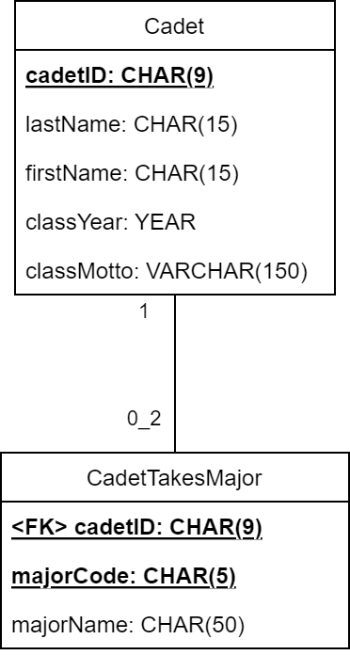
First Normal Form
1NF: values in each column of the table are atomic (singular).
To achieve 1NF, create new classes for any multi-valued attributes.
PK of original set becomes FK of new set
Notes:
1NF: values in each column of the table are atomic.
Which columns have repeating data?
majorCodes and majorNames because a cadet can have more than one major
What do we need to change about the Cadet relation to achieve 1NF?
Separate out the major data into a new class called CadetTakesMajor
CadetTakesMajor has a composite primary key formed by cadetID and majorCode
cadetID is still the PK for Cadet

Slide 10

The 1NF Spreadsheet
cadetID | lastName | firstName | classYear | classMotto
c12345678 | Smith | James | 2036 | What's broke, we fix!
c12345679 | Jones | Susan | 2037 | Seven doesn't rhyme with Jack
c12345680 | Singh | John | 2036 | What's broke, we fix!
c12345681 | Jiang | Sarah | 2036 | What's broke, we fix!
cadetID | majorCode | majorName
c12345678 | CSC1 | Computer Science
c12345678 | NSC1 | Network Sciences
c12345679 | CYM0 | Cyber Sciences: Machine Learning
c12345680 | ENM1H | Engineering Management with Honors
c12345681 | CYM0 | Cyber Sciences: Machine Learning
Notes:
This data is now in First Normal Form. There are no columns that have more than one value in each row
Some issues still remain

Slide 11
The 1NF Spreadsheet
cadetID | lastName | firstName | classYear | classMotto
c12345678 | Smith | James | 2036 | What's broke, we fix!
c12345679 | Jones | Susan | 2037 | Seven doesn't rhyme with Jack
c12345680 | Singh | John | 2036 | What's broke, we fix!
c12345681 | Jiang | Sarah | 2036 | What's broke, we fix!
cadetID | majorCode | majorName
c12345678 | CSC1 | Computer Science
c12345678 | NSC1 | Network Sciences
c12345679 | CYM0 | Cyber Sciences: Machine Learning
c12345680 | ENM1H | Engineering Management with Honors
c12345681 | CYM0 | Cyber Sciences: Machine Learning
What’s the primary key?
Notes:
This data is now in First Normal Form. There are no columns that have more than one value in each row
Some issues still remain

Slide 12
The 1NF Spreadsheet
cadetID | lastName | firstName | classYear | classMotto
c12345678 | Smith | James | 2036 | What's broke, we fix!
c12345679 | Jones | Susan | 2037 | Seven doesn't rhyme with Jack
c12345680 | Singh | John | 2036 | What's broke, we fix!
c12345681 | Jiang | Sarah | 2036 | What's broke, we fix!
cadetID | majorCode | majorName
c12345678 | CSC1 | Computer Science
c12345678 | NSC1 | Network Sciences
c12345679 | CYM0 | Cyber Sciences: Machine Learning
c12345680 | ENM1H | Engineering Management with Honors
c12345681 | CYM0 | Cyber Sciences: Machine Learning
What’s the primary key?
Composite key: cadetID, majorCode
Notes:
This data is now in First Normal Form. There are no columns that have more than one value in each row
Some issues still remain

Slide 13
The 1NF Spreadsheet
Composite key: cadetID, majorCode
cadetID | lastName | firstName | classYear | classMotto
c12345678 | Smith | James | 2036 | What's broke, we fix!
c12345679 | Jones | Susan | 2037 | Seven doesn't rhyme with Jack
c12345680 | Singh | John | 2036 | What's broke, we fix!
c12345681 | Jiang | Sarah | 2036 | What's broke, we fix!
cadetID | majorCode | majorName
c12345678 | CSC1 | Computer Science
c12345678 | NSC1 | Network Sciences
c12345679 | CYM0 | Cyber Sciences: Machine Learning
c12345680 | ENM1H | Engineering Management with Honors
c12345681 | CYM0 | Cyber Sciences: Machine Learning
Is majorCode required to identify majorName?
Yes!
Notes:
This data is now in First Normal Form. There are no columns that have more than one value in each row
Some issues still remain

Slide 14
The 1NF Spreadsheet
Composite key: cadetID, majorCode
cadetID | lastName | firstName | classYear | classMotto
c12345678 | Smith | James | 2036 | What's broke, we fix!
c12345679 | Jones | Susan | 2037 | Seven doesn't rhyme with Jack
c12345680 | Singh | John | 2036 | What's broke, we fix!
c12345681 | Jiang | Sarah | 2036 | What's broke, we fix!
cadetID | majorCode | majorName
c12345678 | CSC1 | Computer Science
c12345678 | NSC1 | Network Sciences
c12345679 | CYM0 | Cyber Sciences: Machine Learning
c12345680 | ENM1H | Engineering Management with Honors
c12345681 | CYM0 | Cyber Sciences: Machine Learning
Is cadetID required to identify majorName?
No! (that’s bad!)
Notes:
This data is now in First Normal Form. There are no columns that have more than one value in each row
Some issues still remain

Slide 15
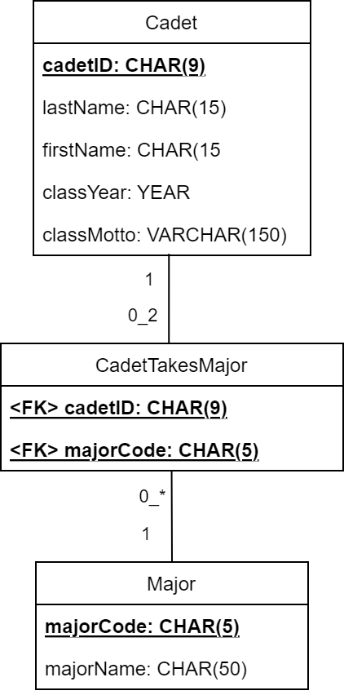
Second Normal Form
2NF: in 1NF, and the entire primary key is needed to identify every non-key field.
To achieve 2NF, create new classes for any columns not dependent on the entire primary key.
Notes:
2NF:
in 1NF,
and the entire primary key is needed to identify every non-key field.
In CadetTakesMajor we have a composite primary key formed by cadetID and majorCode
majorName is not dependent on cadetID, it is only dependent on majorCode
Create a new class called Major which has majorCode as the primary key

Slide 16
The 2NF Spreadsheet
cadetID | lastName | firstName | classYear | classMotto
c12345678 | Smith | James | 2036 | What's broke, we fix!
c12345679 | Jones | Susan | 2037 | Seven doesn't rhyme with Jack
c12345680 | Singh | John | 2036 | What's broke, we fix!
c12345681 | Jiang | Sarah | 2036 | What's broke, we fix!
majorCode | majorName
CSC1 | Computer Science
CYM0 | Cyber Sciences: Machine Learning
NSC1 | Network Sciences
ENM1H | Engineering
cadetID | majorCode
c12345678 | CSC1
c12345678 | NSC1
c12345679 | CYM0
c12345680 | ENM1H
c12345681 | CYM0
Notes:
This data is now in Second Normal Form. The classes Cadet and Major each have a non-composite primary key
Some issues still remain.

Slide 17
The 2NF Spreadsheet
cadetID | lastName | firstName | classYear | classMotto
c12345678 | Smith | James | 2036 | What's broke, we fix!
c12345679 | Jones | Susan | 2037 | Seven doesn't rhyme with Jack
c12345680 | Singh | John | 2036 | What's broke, we fix!
c12345681 | Jiang | Sarah | 2036 | What's broke, we fix!
majorCode | majorName
CSC1 | Computer Science
CYM0 | Cyber Sciences: Machine Learning
NSC1 | Network Sciences
ENM1H | Engineering
What a minute…is cadetID required to know the classMotto
cadetID | majorCode
c12345678 | CSC1
c12345678 | NSC1
c12345679 | CYM0
c12345680 | ENM1H
c12345681 | CYM0
No! (that’s bad!)
Notes:
This data is now in Second Normal Form. The classes Cadet and Major each have a non-composite primary key
Some issues still remain.

Slide 18
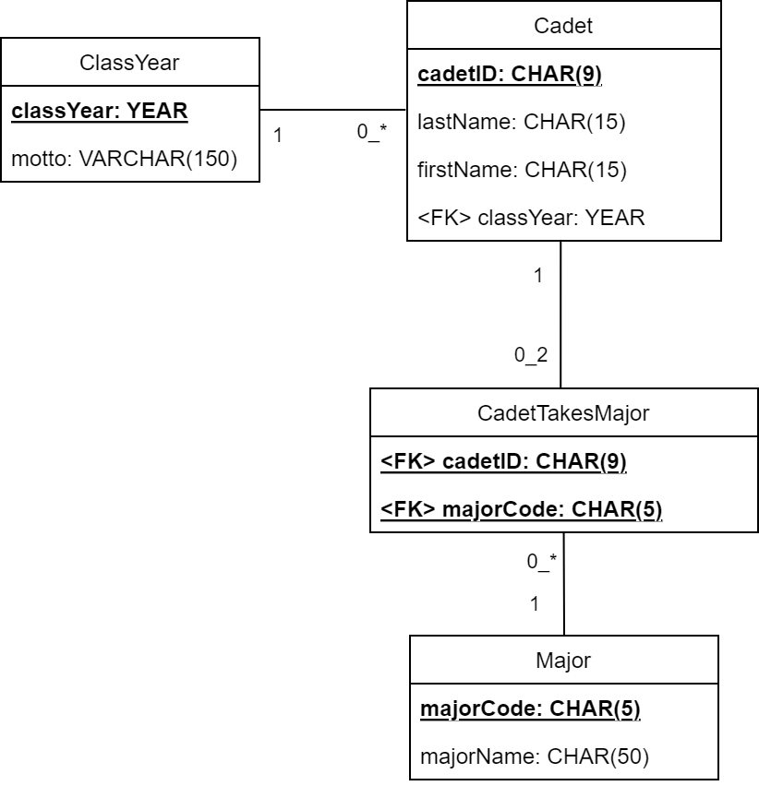
Third Normal Form
3NF: in 2NF, and there are no transitive dependencies.
To achieve 3NF, create new classes for any columns not directly dependent on the primary key.
Notes:
3NF: in 2NF, and there are no transitive dependencies.
Transitive A -> B, B->C, A -> C
There should not be any non-primary key attributes dependent on another non-primary key attribute
What information in the cadet table is not *directly* dependent on the primary key?
classMotto depends on classYear
What do we need to do to achieve 3NF?
Break out classYear and classMotto into another class called ClassYear with classYear as the primary key
ClassYear is in a 1 to Many relationship with Cadet so we add classYear as a foreign key to Cadet

Slide 19

The 3NF Spreadsheet
cadetID | lastName | firstName | classYear
c12345678 | Smith | James | 2036
c12345679 | Jones | Susan | 2037
c12345680 | Singh | John | 2036
c12345681 | Jiang | Sarah | 2036
majorCode | majorName
CSC1 | Computer Science
CYM0 | Cyber Sciences: Machine Learning
NSC1 | Network Sciences
ENM1H | Engineering
classYear | motto
2036 | What's broke, we fix!
2037 | Seven doesn't rhyme with Jack
cadetID | majorCode
c12345678 | CSC1
c12345678 | NSC1
c12345679 | CYM0
c12345680 | ENM1H
c12345681 | CYM0
Notes:
This data is now in Second Normal Form. The classes Cadet and Major each have a non-composite primary key
Some issues still remain.

Slide 20
Normalization

Slide 21
But why?
Normalization prevents three types of update anomalies:
Insertion
Deletion
Modification
If I have redundant data, what bad things can happen when I insert, delete, or modify data?

Slide 22
ICE: Put into 1NF and show schema

Slide 23
ICE: Put into 2NF and show schema

Slide 24
ICE: Put into 3NF and show schema

Slide 25
ICE: Complete!

Slide 26
ICE
Download the csv from Canvas
Check it out

Slide 27
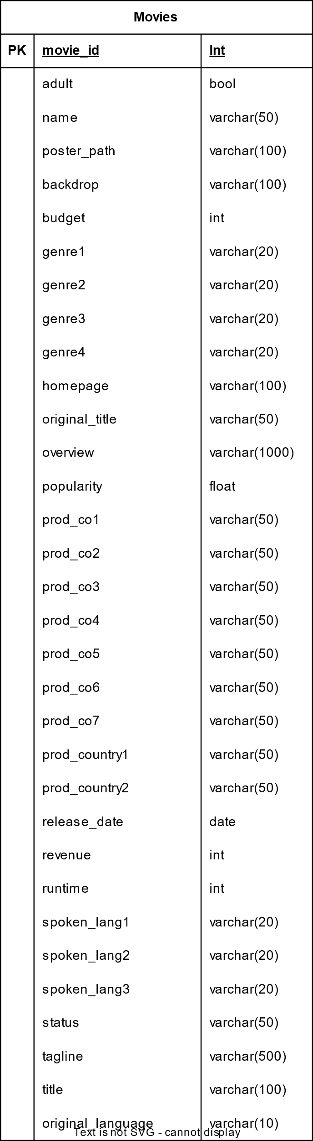
No Normalization

Slide 28
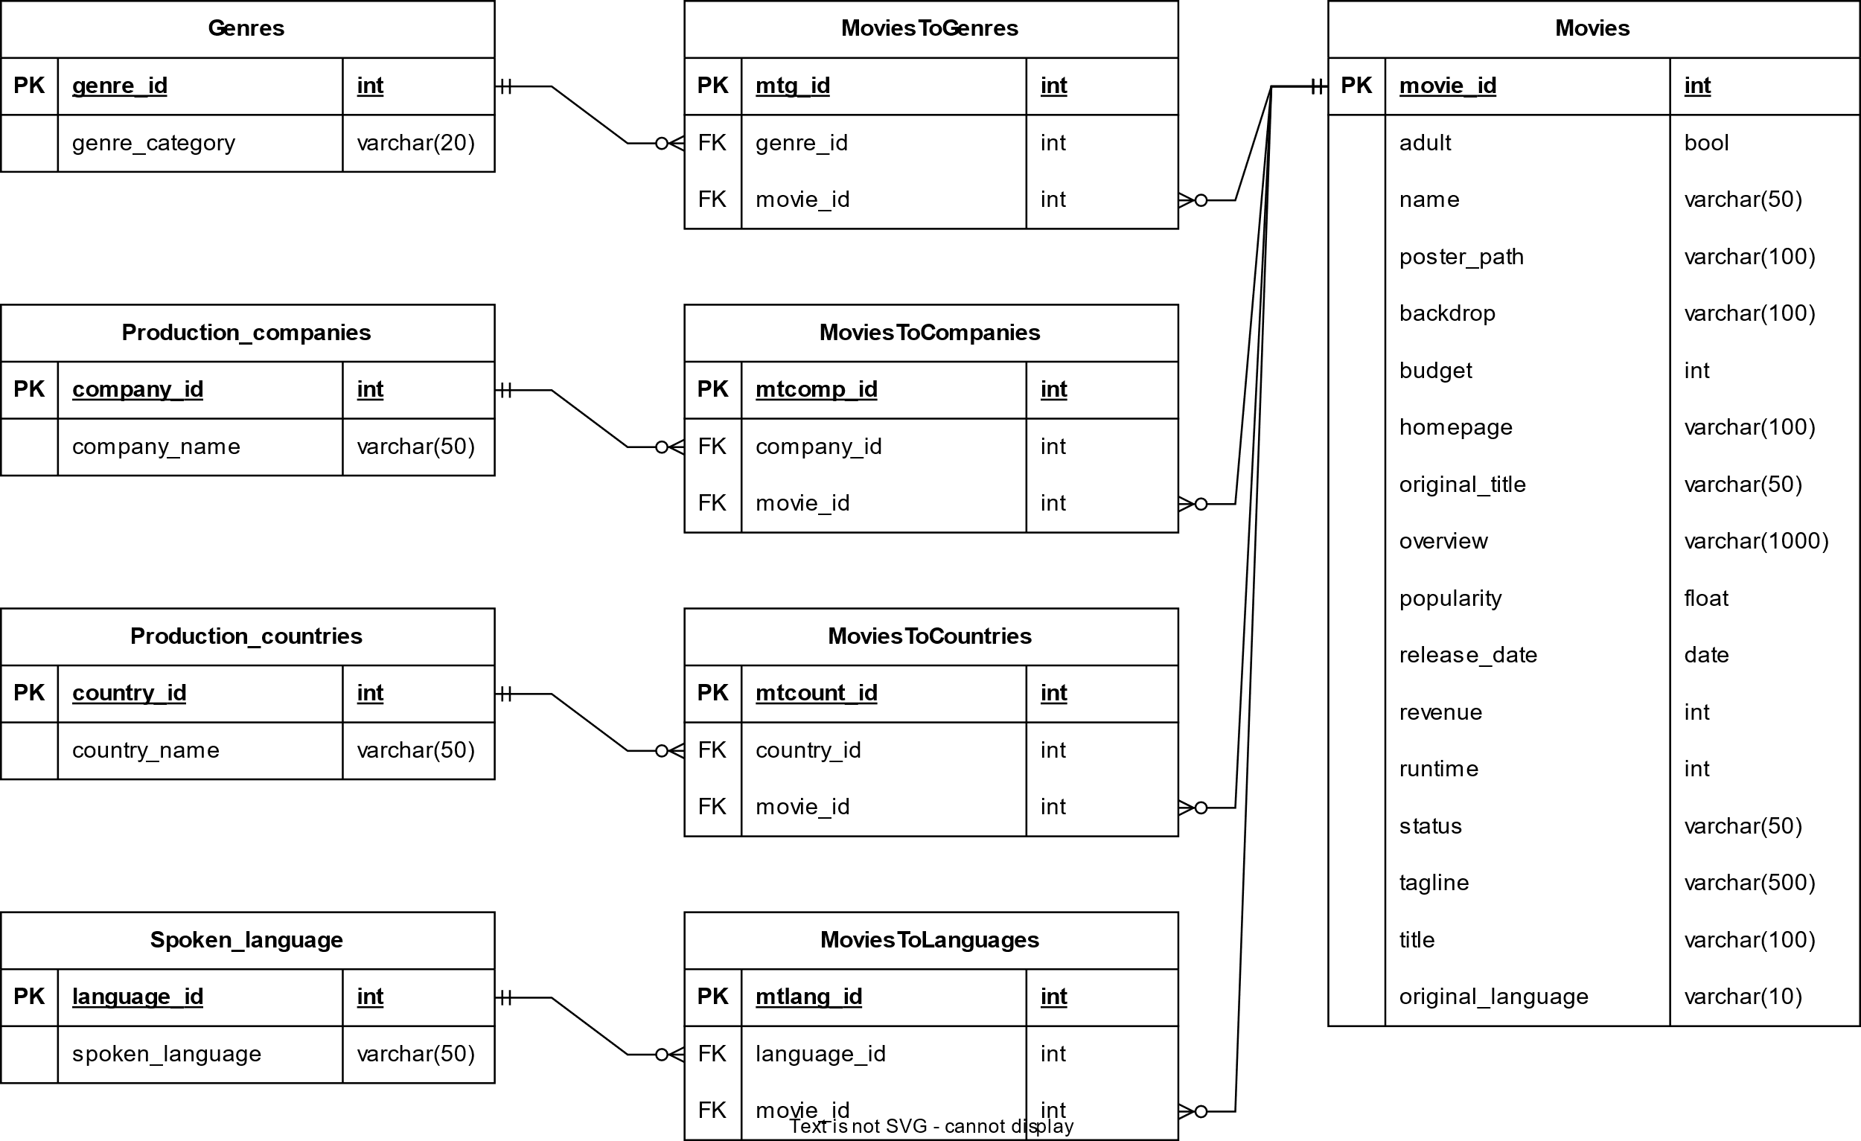
First Normalization

Slide 29
First Normalization Tables

Slide 30
Bridge / Linking / Joining / Relational Tables
This is the magic of the connecting
tables. We can identify every time something has occurred in this table and use it to find the data with queries.

Slide 31
Second Normalization
Second Normal Form (2NF) requires that a relation is in 1NF AND every non-key attribute is fully dependent on primary key.
Slightly easier version: can I determine any information in a table without using all the primary keys?
Composite key struggles
A table in 1NF with only a single unique primary key jumps straight to 2NF

Slide 32

Second Normalization

Slide 33
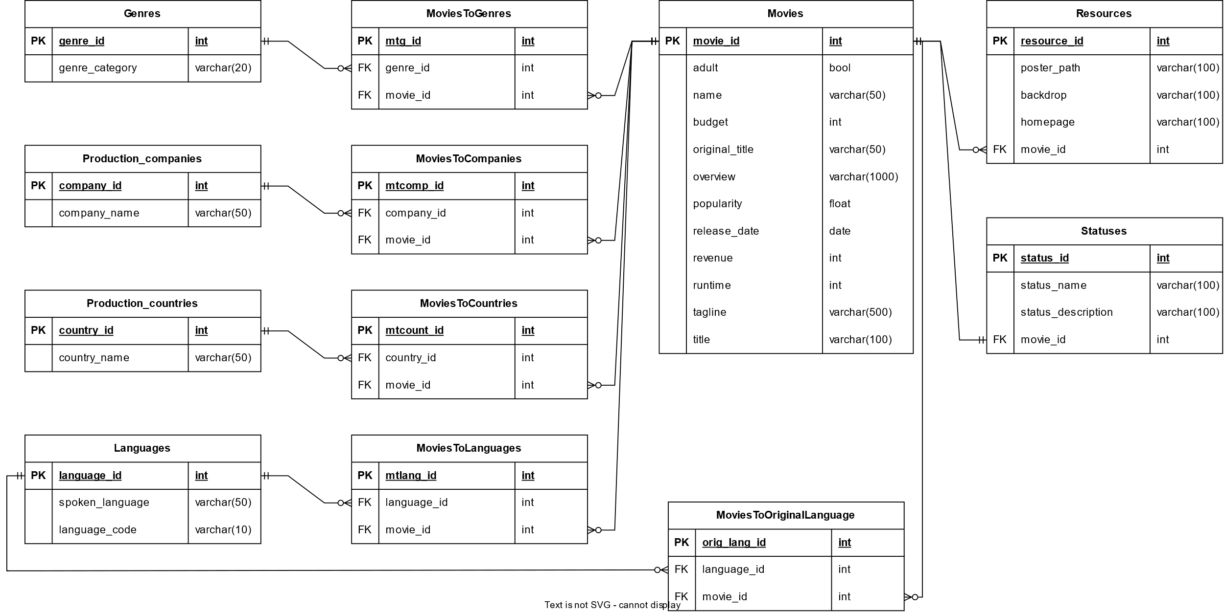
Third Normalization

